Slide 1
Implementation Object Linking and Embedding for Processes Control Unified Architecture Specification on Secure Device
The future standard for communication and information modeling in automation
Yuankui Wang

Slide 2
Agenda
Reminder
Application Scenario
Objectives
Implementation Details
Implementation Tools
Reference

Slide 3
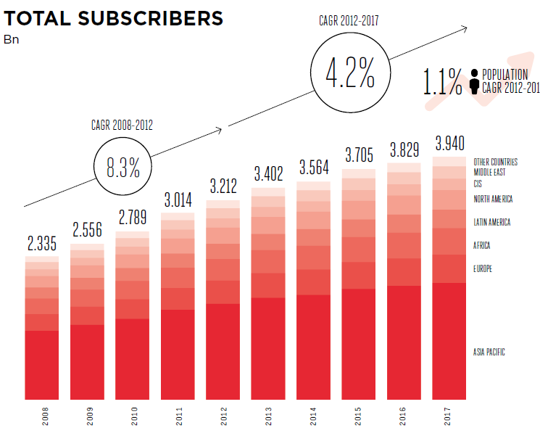
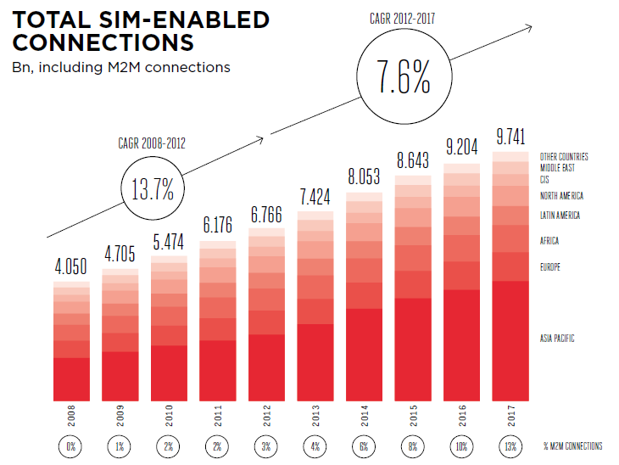
Reminder
3.402 billion mobile subscribers in 2013 = half population on the earth
Firms in many industry sectors now employing M2M applications to boost productivity and open new markets
With mobility people, processes and assets are always connected.
How to exploit the potentialities of mobile technology to benefit customers

Slide 4
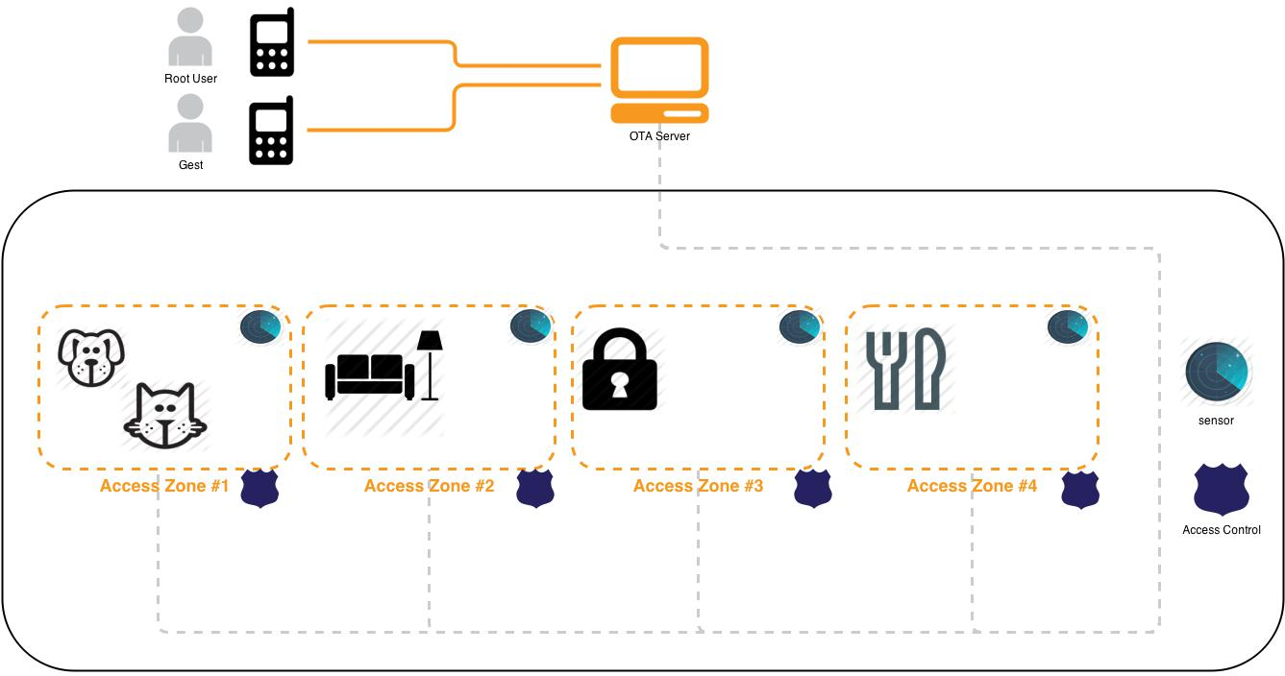
Application Scenario
Smart Home = Sensors + Control Device + Digital Lock + Cell Phone

Slide 5

Application Scenario
Common Interface
Solution: OPC UA standards
Security guarantee
OPC UA secure model
Smart card security mechanisms

Slide 6
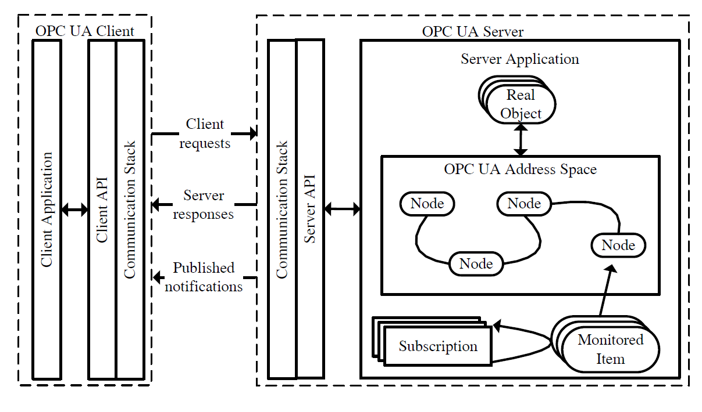
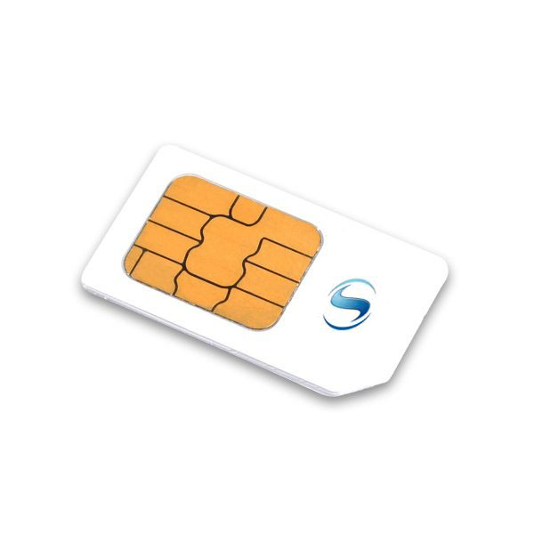
Application Scenario
Smart Card / UICC: Well-established security token in many domains
OPC UA: Communication standard for industrial automation

Slide 7
Application Scenario
Server
Manage real field device
Process command/configuration from client
Publish notification based on corresponding subscription
Record historical data

Slide 8
Application Scenario
Client (Cell phone user)
Send command/configuration data to server
Query server state
Submit subscription and receive notification
Grant access rights to others

Slide 9
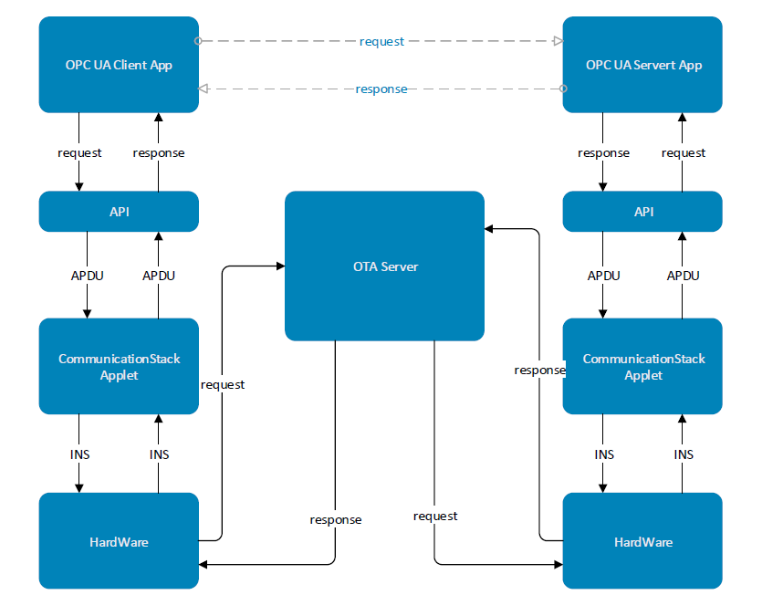
Application Scenario

Slide 10
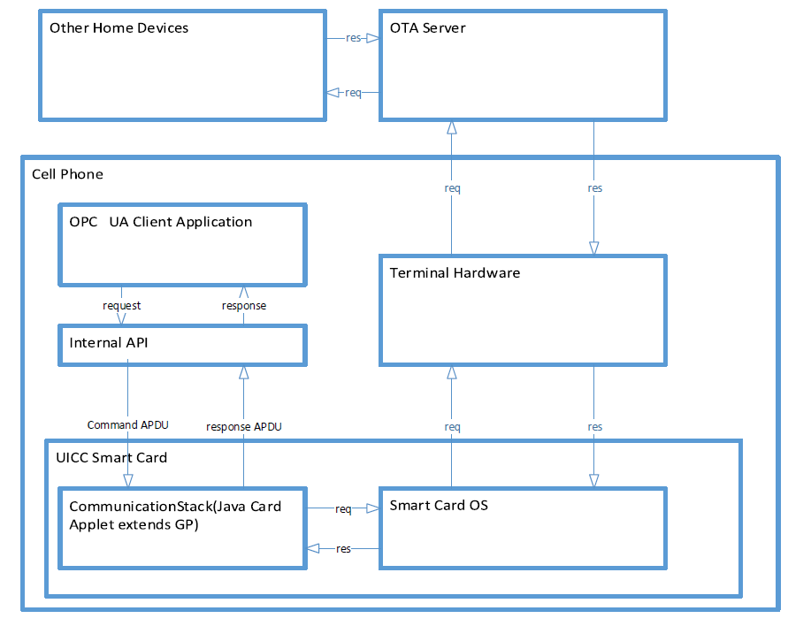
Application Scenario: Client Request

Slide 11
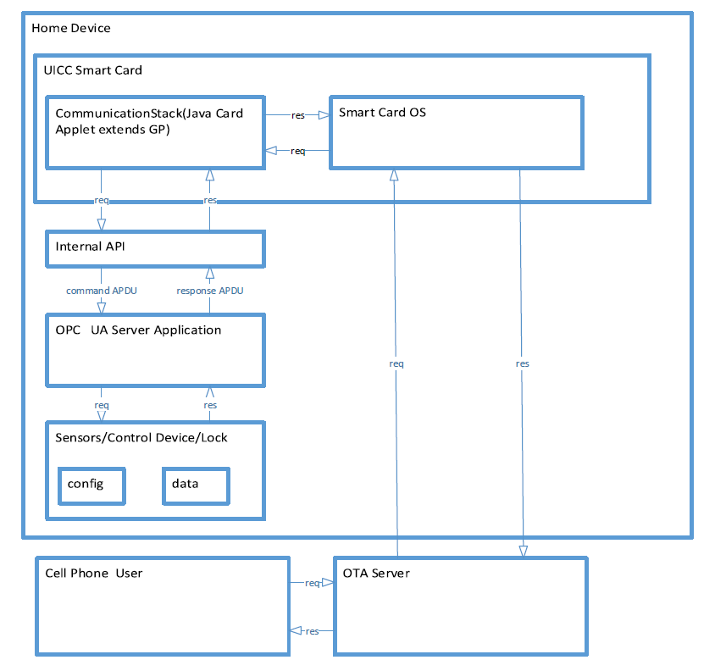
Application Scenario: Client Request

Slide 12
Objectives
Apply recently released OPC UA standards to offer an application level secure communication interface
Explore secure benefits brought by smart card technologies
Combine aforementioned technologies together to build a remote control infrastructure to benefit users with mobility and security services
Develop an application scenario for the purpose of concept demonstration

Slide 13
Objectives
System security and performance analysis based on implementation secnario
prove reliability and feasibility of my proposal
with the help of attack-tree-graph step by step analyze traditional and potential attack against designed system
claim corresponding countermeasures
analyze performance of system
delay
server process message ability

Slide 14
Implementation Details
Develop OPC UA standard satisfying communication stack on UICC smart card as Java Card Applet
Extends APIs from GlobalPlatform Remote Application Management
Realize secure communication between client/server
User/application authentication
Message integrity and confidentiality check
Rebuild broken channel mechanism
Design android app as OPC UA client at the cell phone user side to provide a user friendly interface
With the help of demo code provided by OPC Foundation to simulate OPC UA client/server application code.
Simulate OTA server using UTE from Morpho

Slide 15
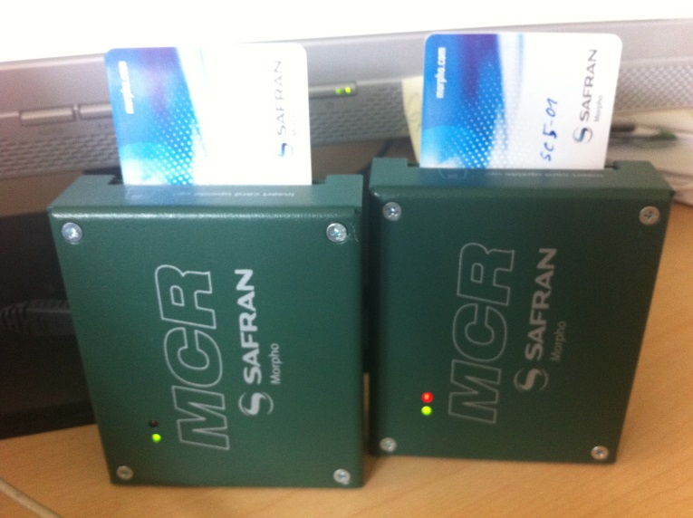
Implementation Tools
Universal Test Environment
Test case creation
Communication parties simulation
Jacade = Java Card Applet development environment
Applet creation and debugging tools
Large collections of functions and software models
Jvc = Java virtual card
iCardreader
Monitor APDU communication
between card and terminal
MCR card reader
Connected chip card with PC

Slide 16
Rerferences
[1] GSMA: The Mobile Economy 2013
[2]Sanjay J.Pooen: How Mobility is Changing the World
[3]OPC UA specification 1-11
[4]Jahanzaib Imtiaz and Juegen Jasperneite, Scalability of OPC-UA Down to the Chip Level Enables "Internet of Things“
[5]Stefan-Helmut Leitner and Wolfgang Mahnk: Opc ua-service-oriented architecture for industrial applications
[6]Wolfgang Mahnke, Stefan-Helmut Leitner:OPC Unified Architecture
[7]Wolfgang Rankl und Wolfgang Eng: Handbuch der chipkarten - 5. deutsche auflage. (2008)

Slide 17
Thank you! Question?

Slide 18
OPC UA Client Server Architecture

Slide 19
OPC UA Client Server Architecture
Client Application: Java Phone APP
Supported client functions:
Query
Authentication
Authorization and etc…
Communication stack: developed on smart card, used to realize communication with OPC UA server.
Important user credential information like: encryption keys and certificates are saved on card.
Client API: Translate App instructions into Application Protocol Date Unit (APDU) formats.

Slide 20
OPC UA Client Server Architecture
Real Object: Field devices, abstract date.
Node: Real Objects are represented by Nodes.
Address Space: Information that can be viewed by OPC UA clients
Subscription: Client can subscript particular information
Monitored Item: manage subscripted Nodes.
Server API: Translate Server application instructions
Communication Stack: realize commutation with OPC UA client

